Slide 1
Competitive Pricing
Pricing Strategies
2020
Jean-Pierre Dubé
© Copyright 2020

Slide 2
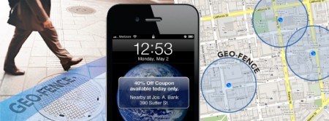
Geo-Conquesting New Data sources: real-time mobile location

Slide 3

Geo-Conquesting Targeting competitor’s customers
Driving up to a McDonald's location unlocks a one-cent Whopper deal via Burger King's mobile app.
“Burger King’s New Trolling Ploy Sends Fans to McDonald’s to Unlock a 1-Cent Whopper Deal: Whopper Detour gets catty with geotargeting,” by Gabriel Beltrone, AdWeek, 12-4-2018.

Slide 4
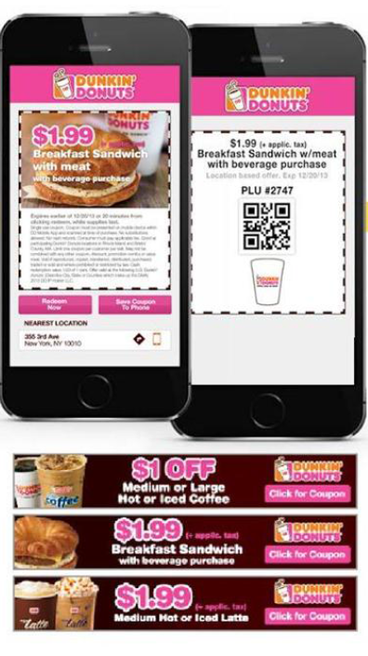
Geo-Conquesting Targeting competitor’s customers
Targeting competitive locations to drive coupon redemption
Dunkin’: 3.6%
Department store: 2%
Quizno’s: 6% lift over national average
Source of incremental sales…
What if the competitor reacts?

Slide 5
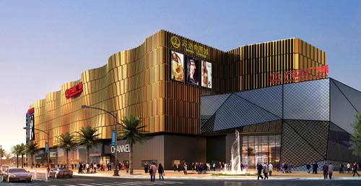
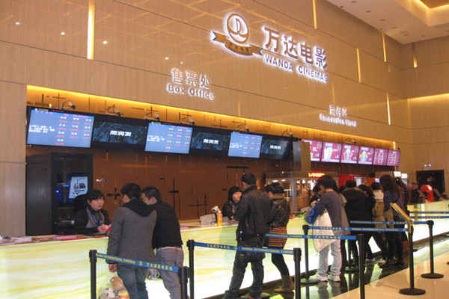
Mobile Geo-Conquesting: Chinese Movie Theaters
Smartphones ≈70% of mall traffic
Mobile geo-positioning (GPRS) can determine real-time location

Slide 6
Geo-Conquesting Example: SMS discounts for movie theaters
Experimental design
2 movie theaters in nearby shopping malls in large Chinese city
Regular ticket prices 75 RMB
11am-noon on Saturday (low-demand period)
9,000 random users from each mall’s 500m geo-fence
Mobile Price Targeting
Off-peak time: 11am-noon on Saturday (early-bird rate)
Geography: consumers already near malls
Source: Dubé, Fang, Fong and Luo (2017)

Slide 7
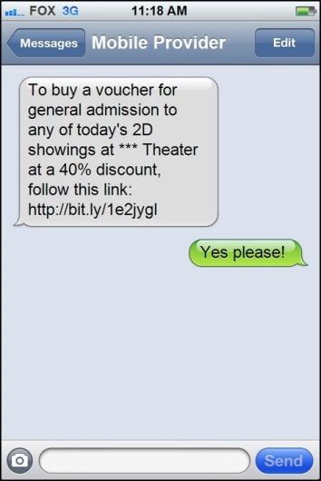
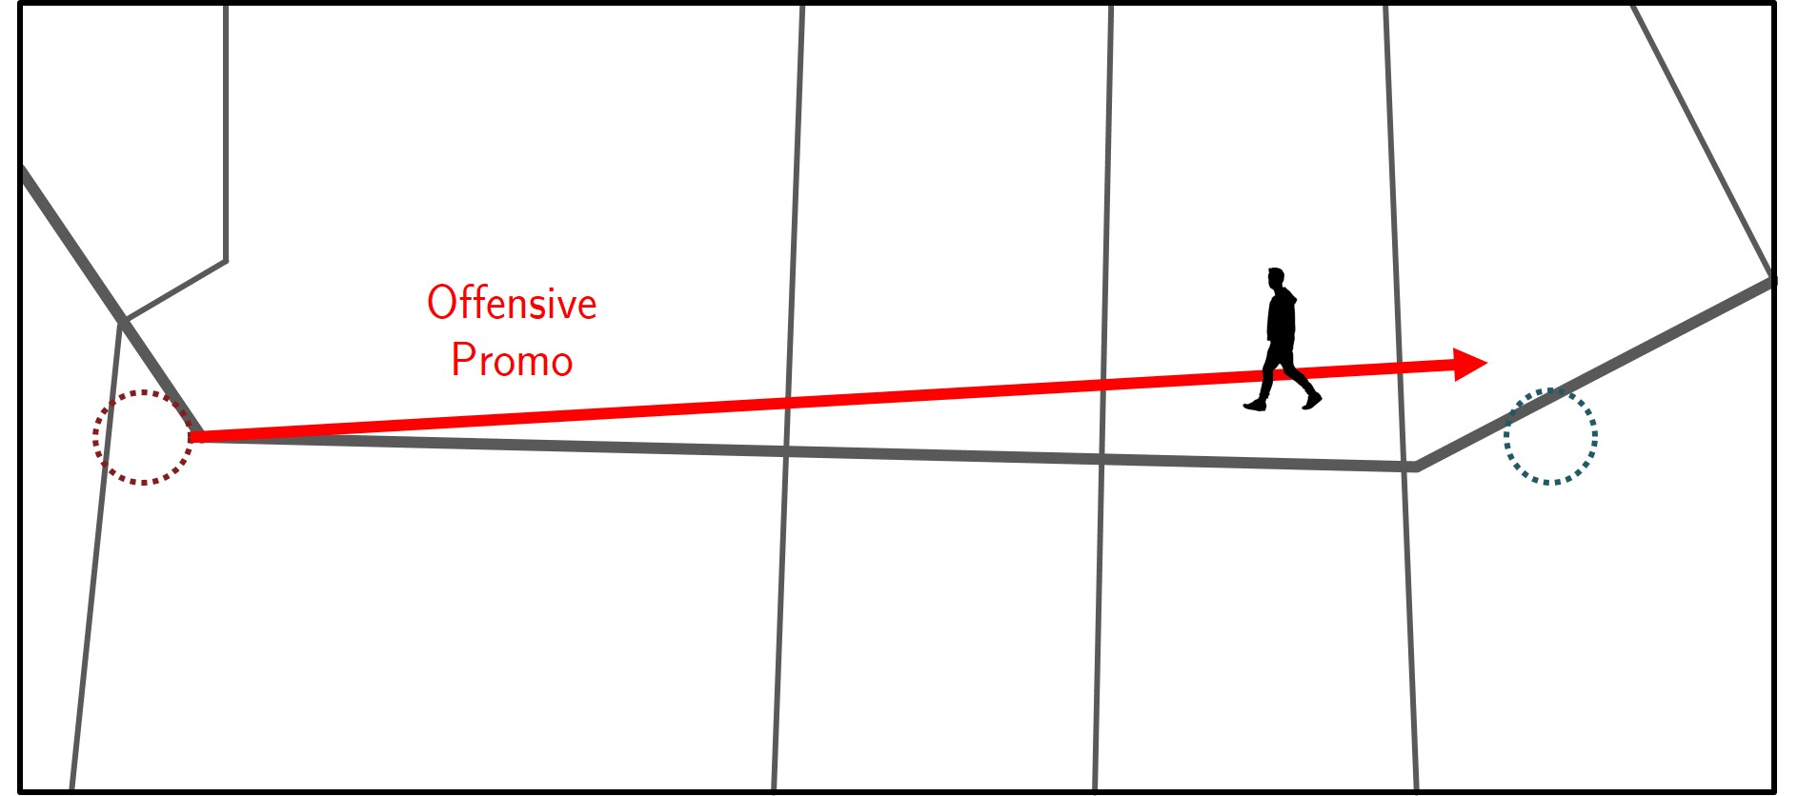
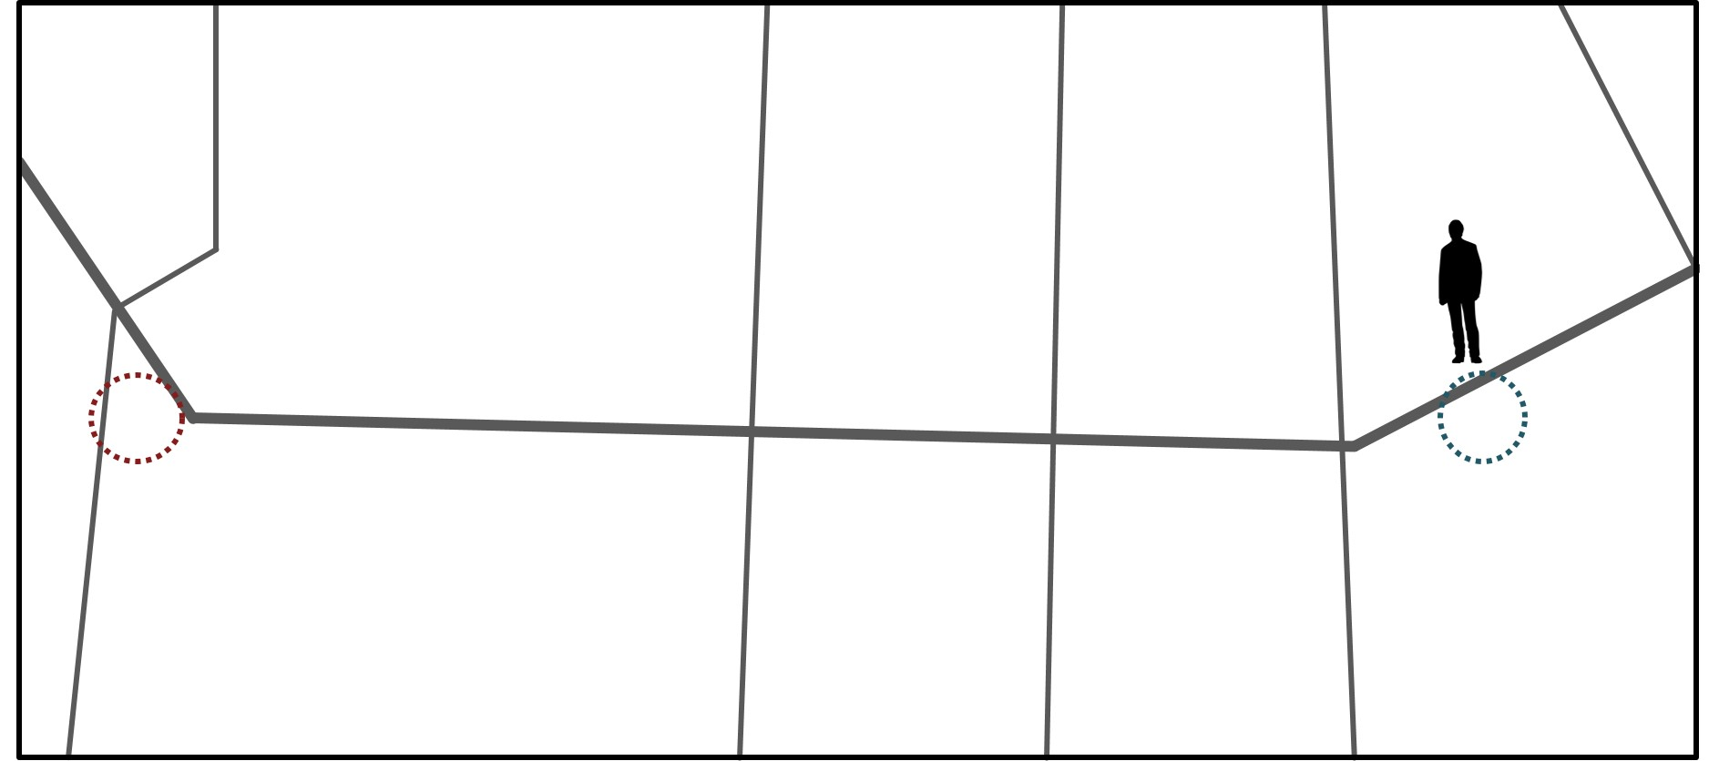
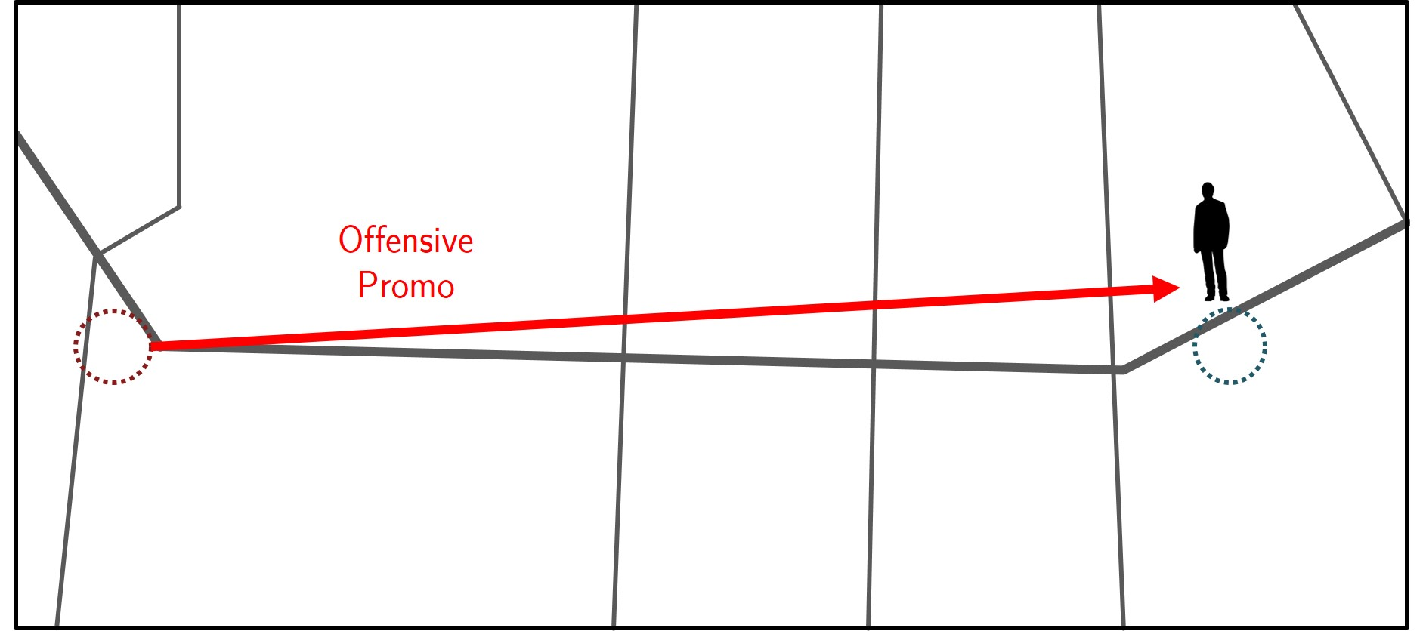
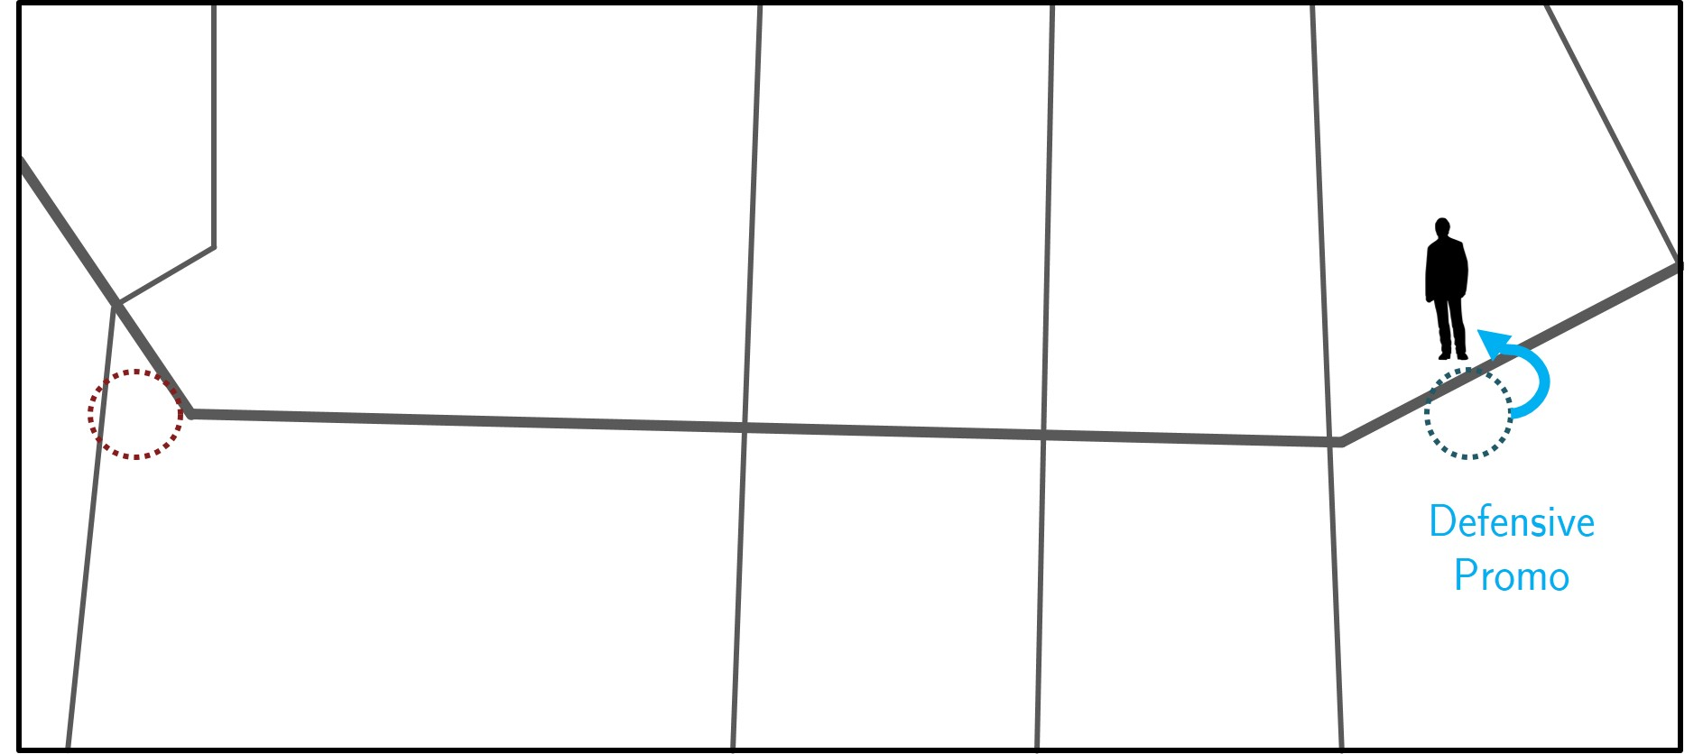
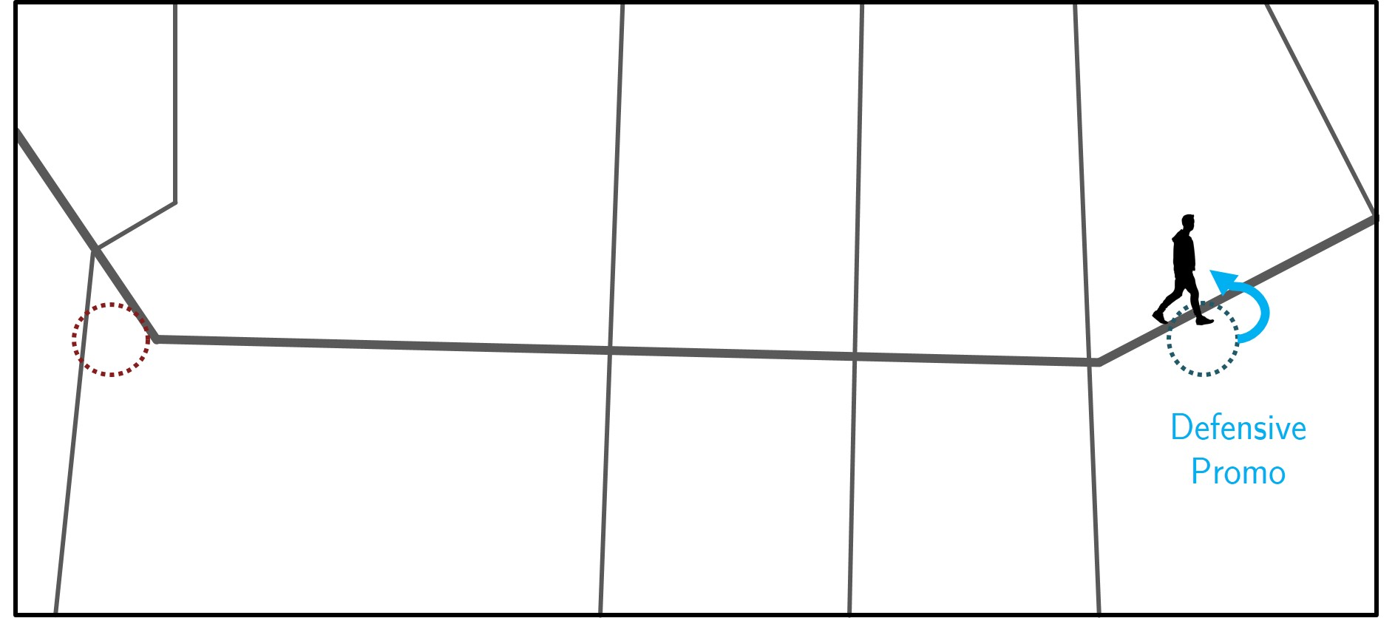
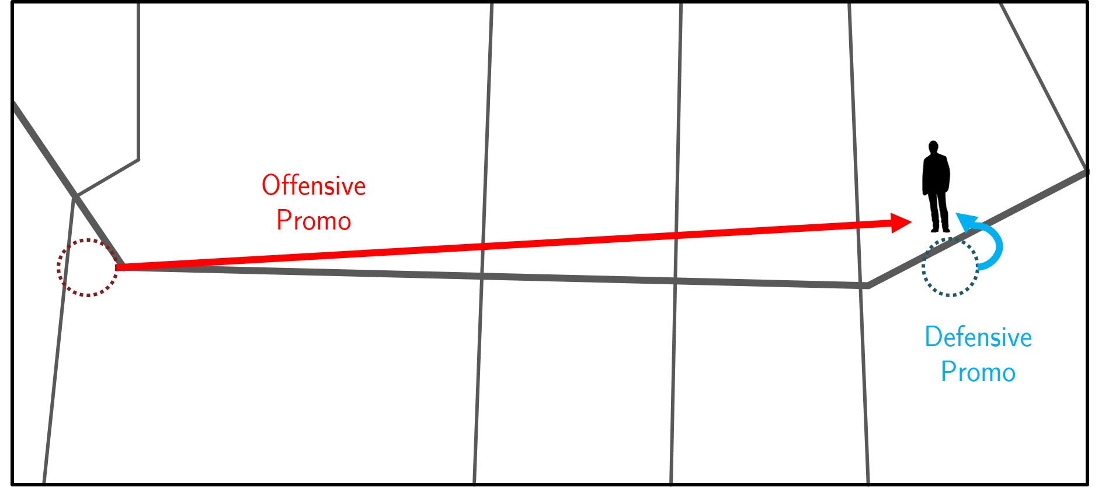
Geo-Conquesting Example: SMS discounts for movie theaters
Either firm benefits from unilateral targeting
But what happens when both target?!

Slide 8
Mobile Geo-Fencing only Example: Chinese movie theaters
What about
Geo-CONQuesting?
Source: Dubé, Fang, Fong and Luo (2017)

Slide 9
Mobile Geo-Conquesting Example: Chinese movie theaters
Source: Dubé, Fang, Fong and Luo (2017)

Slide 10
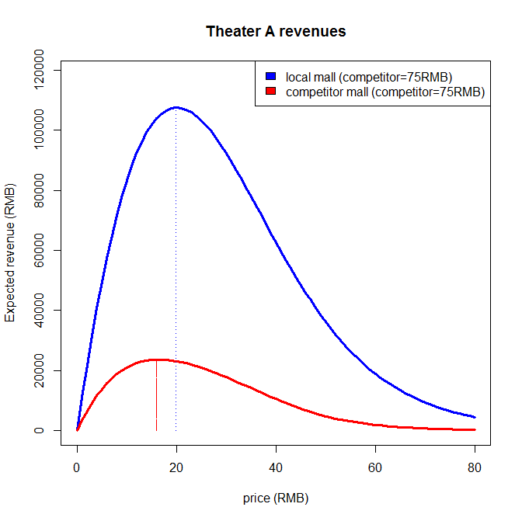
Geo-Conquesting Example: SMS discounts for movie theaters
Based on probit demand regression using field test data.
What about
Competitor?
Regular price (75 RMB)
Targeting low price in competitor mall stimulates new business!

Slide 11
Mobile Geo-Conquesting Example: Chinese movie theaters
Source: Dubé, Fang, Fong and Luo (2017)

Slide 12
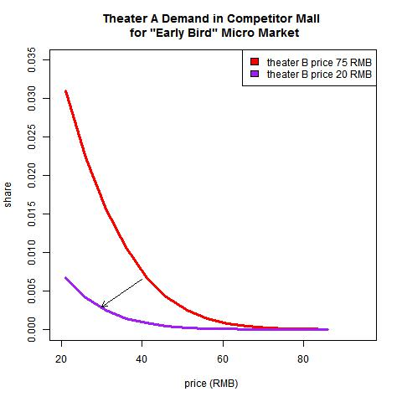
Geo-Conquesting & competitor response Example: Chinese movie theaters
Uh-oh, demand for theater A from competitor’s mall shifts in a LOT when theater B reacts!!!

Slide 13
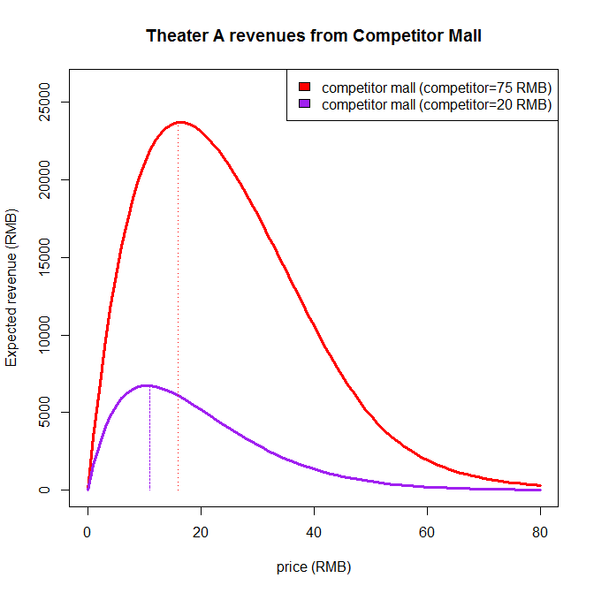
Geo-Conquesting Example: SMS discounts for movie theaters
Regular price (75 RMB)
Competitor response offsets 80% of incremental profitability of geo-conquesting

Slide 14
Challenge with Targeted Pricing Competitive Reactions
Price targeting not guaranteed to increase profits if competitors can launch a competing price-targeting campaign
In equilibrium it’s possible to fall into a prisoner’s dilemma
Targeting may trigger price wars in each firm’s local market

